Slide 1
Coded Inequalities
VIGNESH M

Slide 2
1. In the given questions, assuming the given statements to be true, find which of the given four conclusions I, II, III and IV stands definitely true and give your answer accordingly.1.
Statement: S > M ≥ D > H ≤ R ≤ T < W
Conclusions: I.S > H II. W > H III. R < W IV. M > T
(a) I, II and III are true (b) Only II is true (c) I and II are true (d) I and either II or IV are true
(e) All I, II, III and IV are true
2. Statement: P < Q = R ≥ S ≥ T Conclusion: I. T ≤ Q II. R > P
3. Which of the following expressions will be true if the given expression K ≥ G > H ≤ F is definitely true?
(a) F ≥ K (b) H < K (c) F < G
(d) K ≥ H (e) None of these

Slide 3
(a) Only conclusion I follows. (b) Only conclusion II follows. (c) Either conclusion I or II follows. (d) Neither conclusion I nor II follows. (e) Both conclusion I and II follow.
4. Statement: P ≥ Q = R > S > T Conclusion: I. R ≥ T II. T < P
5. Statement: L ≤ M < N > O ≥ P Conclusion: I. O < M II. P ≤ N

Slide 4
Give answer
(a) if only conclusion I is true (b) if only conclusion II is true (c) if either conclusion I or II is true
(d) if neither conclusion I nor II is true (e) if both conclusions I and II are true
2. Statement: P < Q = R ≥ S ≥ T Conclusion: I. T ≤ Q II. R > P

Slide 5
3. Which of the following expressions will be true if the given expression K ≥ G > H ≤ F is definitely true?
(a) F ≥ K (b) H < K (c) F < G
(d) K ≥ H (e) None of these

Slide 6
In each of the following questions, relationship between different elements is shown in the statements. These statements are followed by two conclusions.
Give answer
(a) if only conclusion I is true (b) if only conclusion II is true (c) if either conclusion I or II is true
(d) if neither conclusion I nor II is true (e) if both conclusions I and II are true
6.Statement: A < B = C, D > C = E
Conclusions: I. E ≥ A II. A < D
7. Statement: A ≤ B < C; A ≥ D; C ≤ F Conclusion: I. D < C II. F ≥ D
8. Statement: P ≥ Q = R, Q > S > T Conclusions: I. P ≥T II. T < R

Slide 7
Directions for Q7 to Q8: In these questions, relationship between different elements is shown in the statements. These statements are followed by two conclusions.
Give answer
(a) if only conclusion I is true (b) if only conclusion II is true (c) if either conclusion I or II is true
(d) if neither conclusion I nor II is true (e) if both conclusions I and II are true
7. Statement: A ≤ B < C; A ≥ D; C ≤ F Conclusion: I. D < C II. F ≥ D
8. Statement: P ≥ Q = R, Q > S > T Conclusions: I. P ≥T II. T < R

Slide 8
Directions for Q9 and Q10: In each of the following questions, relationship between different elements is shown in the statements. These statements are followed by two conclusions.
Give answer
(a) If only conclusion I follows.
(b) If only conclusion II follows.
(c) If either conclusion I or II follows.
(d) If both conclusion I and II follow.
9. Statement: P ≥ Q = R, Q > S > T
Conclusions: I. P ≥S II. T < Q
10. Statement: F ≥ G = H, G > J ≥ K
Conclusions: I. F ≥ K II. K < H

Slide 9
In this question, relationship between different elements is shown in the statements. Give answer (a) if only conclusion I is true (b) if only conclusion II is true (c) if either conclusion I or II is true (d) if neither conclusion I nor II is true (e) if both conclusions I and II are true
11. Statement: F ≥ G = H; G > J ≥ K Conclusion: I. F ≥ K II. K < H

Slide 10
Directions for Q12 to Q15: In these questions, relationship between different elements is shown in the statements. These statements are followed by two
conclusions. Mark answer if (a) Only conclusion I follows. (b) Only conclusion II follows. (c) Either conclusion I or II follows. (d) Neither conclusion I nor II follows. (e) Both conclusion I and II follow.
12. Statement: A > B, B ≥ C = D < E Conclusion: I. C < A II. D ≤ B
13. Statement: H > J = K, K ≥ L, L > T, T < V Conclusion: I. K > T II. L ≤ H
14. Statement: A ≤ B = C, D > C = E Conclusion: I. C ≥ A II. B < D
15. Statement: Z > T, T < M, M < J Conclusion: I. T < J II. J < Z

Slide 11
16. Statement: J ≥ A > D = E; L < A < M
Conclusions: I. M < J II. J > L
III. D > L IV. E < M
(a) Only II is true
(b) I and III are true
(c) None is true
(d) II and IV are true
(e) I and II are true

Slide 12
17. Statement: Y > F ≤ O ≤ P; F ≥ U < T
Conclusions: I. Y > P II. T < F
III. O > T IV. P < U
(a) Only I is true
(b) Only II is true
(c) Only III is true
(d) None is true
(e) I and IV are true

Slide 13
18. Statement: M > H ≤ Y ≤ R < U = Z ≥ E
Conclusions: I. M > R II. Z ≤ R
III. R > E IV. Z > H
(a) I and II are true
(b) Only IV is true
(c) None is true
(d) II and IV are true
(e) II and III are true

Slide 14
19. Statement: M > U > L ≤ N; L ≥ Y > A
Conclusions: I. Y < N II. M > N
III. N = Y IV. M > A
(a) Only either II or III is true
(b) IV and either I or III are true
(c) Only IV is true
(d) Only II is true
(e) Only III is true

Slide 15
20 Statement: P > Q ≤ C ≤ B = M > D
Conclusions: I. M > Q II. D < P
III. M = Q IV. C > D
(a) None is true
(b) Only IV is true
(c) Only either I or III is true
(d) III and II are true
(e) Only is true

Slide 16
Directions (21-23): In these questions,
i) A @ B means A is not smaller than B.
ii) A # B means A is not greater than B
iii) A $ B means A is neither greater than nor smaller than B.
iv) A + B means A is neither smaller than nor equal to B.
v) A % B means A is neither greater than nor equal to B
21. Statements: Y $ W , W @ O , O # H
Conclusions I. Y + O II. H % W III. H + Y
A. None follows
B. Only I follow
C. Only II follow
D. Only III follow
E. Only II & III follows

Slide 17
22.Statements: B + M , M @ Z , Z $ C
Conclusions: I. C + M II. B + Z III. C + B
A. Only II follows
B. Only I and III follows
C. Only I follow
D. Only III follow
E. None of these

Slide 18
23.Statements: N @ S , S % M , M + H
Conclusions: I. M # N. II. N + H. III. M + N
A. Only II follows
B. Only I and II follows
C. Only III follows
D. Either I or III follows
E. None of these

Slide 19
24. Given signs signify something and on that basis, assume the given statement to be true. Answer the question based on the information provided.
"%" denotes "greater than"
">" denotes "equal to"
"=" denotes "not less than"
"@" denotes "not equal to"
"#" denotes "less than"
"*" denotes "not greater than"
Statements:
P > S, S @ T, P # R
Conclusions:
I. S % R
II. P @ T
(a) Only conclusion I is true
(b) Only conclusion II is true
(c) Neither conclusion I nor II is true
(d) Both conclusion I and II are true

Slide 20
25. “A+B” means “A is greater than B”
“A–B” means “A is less than B”
“A=B” means “A is greater than equal to B”
“A*B” means “A is equal to B”
“A/B” means “A is not equal to B”
Statements:
D=E, E+F, F/G
Conclusions:
I. D+F
II. F*G
(a) Only conclusion I is true
(b) Only conclusion II is true
(c) Neither conclusion I nor II is true
(d) Both conclusions I and II are true

Slide 21
25. “A+B” means “A is greater than B”
“A–B” means “A is less than B”
“A=B” means “A is greater than equal to B”
“A*B” means “A is equal to B”
“A/B” means “A is not equal to B”
Statements:
D=E, E+F, F/G
Conclusions:
I. D+F
II. F*G
(a) Only conclusion I is true
(b) Only conclusion II is true
(c) Neither conclusion I nor II is true
(d) Both conclusions I and II are true

Slide 22
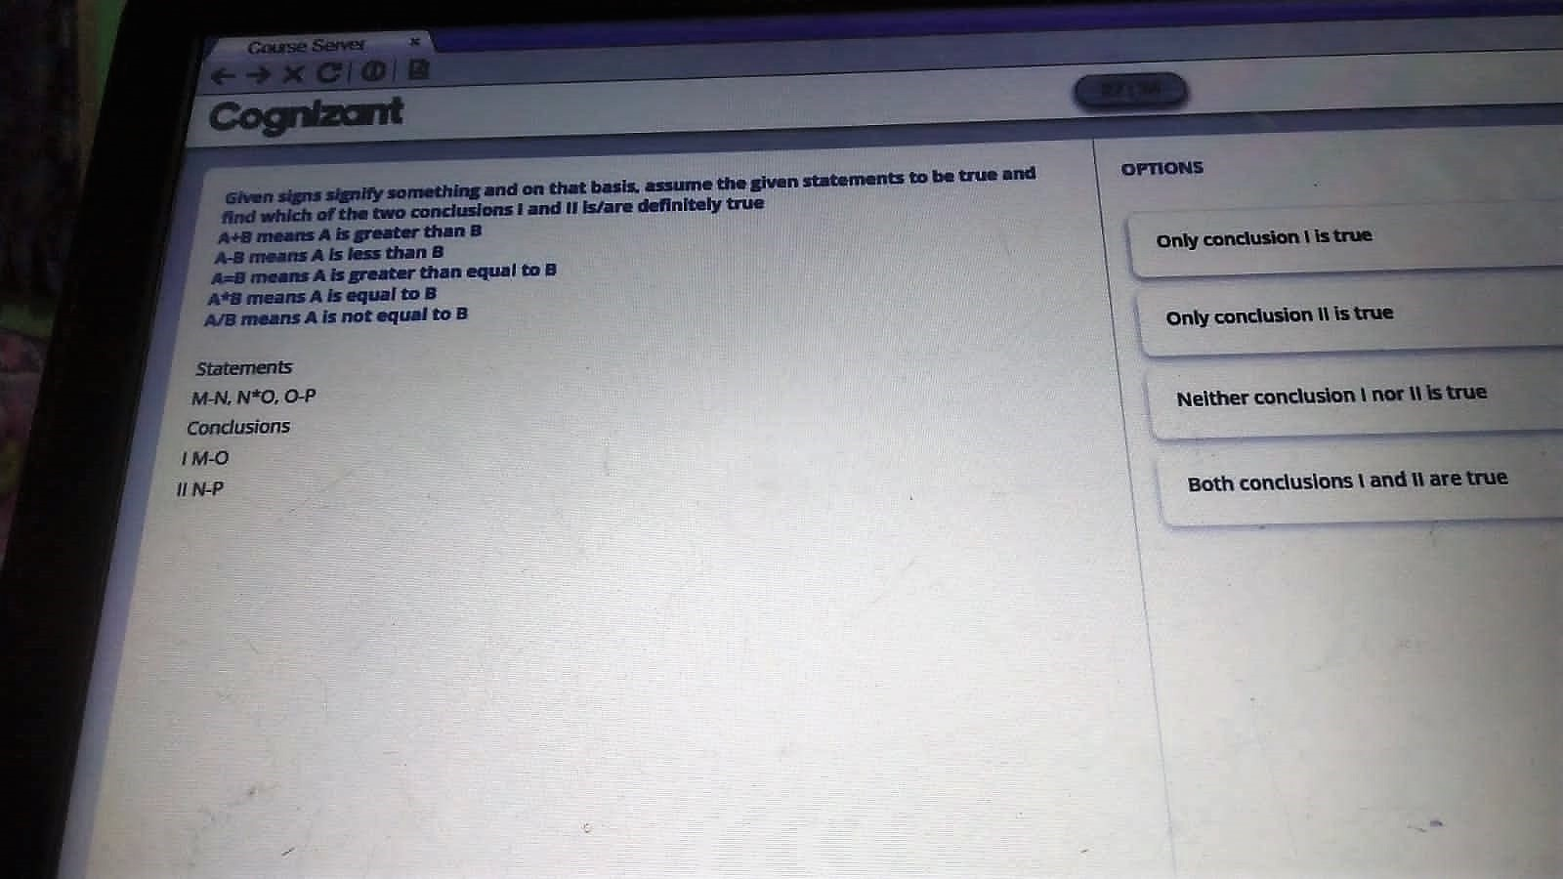

Slide 23
THANK YOU

